Slide 1
RSN and RSN Information Element

Slide 2
RSN
A security association is a set of policies and keys used to protect information.
A robust security network association (RSNA) requires two 802.11 stations (STAs) to establish procedures to authenticate and associate with each other as well as create dynamic encryp-tion keys through a process known as the 4-Way Handshake. This association between two stations is referred to as an RSNA.
or
Any two radios must share dynamic encryption keys that are unique between those two radios.
RSN element has an element ID of 48
1. Beacon frames.(send by AP)
2. Probe Response frames.(send by AP)
3. Association Request frames.(send by Client)
4. Reassociation Request frames (Send by client)

Slide 3
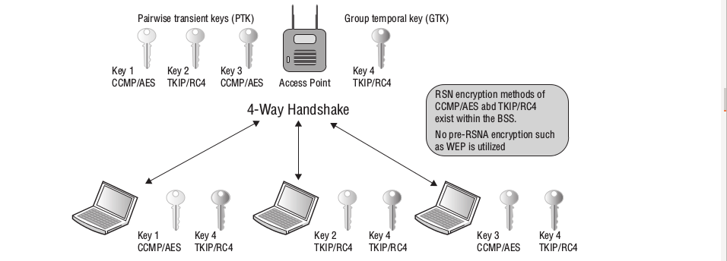
Robust Security Network
* The unique dynamic TKIP/RC4 or CCMP/AES key that is shared between the client radio and the access point radio.This key is called the pairwise transient key and is used to encrypt/decrypt unicast traffic.
* All the stations share a broadcast key called the group temporal key (GTK), which is used
to encrypt/decrypt all broadcast and multicast traffic.

Slide 4
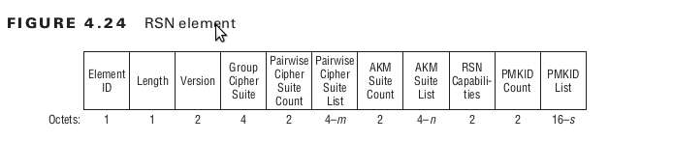
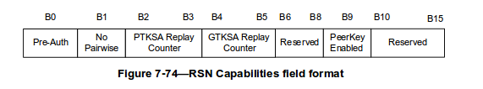
RSN Element

Slide 5
RSN Element Description
* Pairwise unicast encryption keys are created that are unique between two stations—the AP and a single client station. The pairwise cipher suite of the RSN information element contains the cipher suite information used by stations for unicast traffic.
* A group key is also created that is shared by all stations for broadcast and multicast traffic. The Group Cipher Suite field of the RSN information element contains the cipher suite information used by the BSS to pro-tect broadcast/multicast traffic.
AKM:- The RSN information element can also be used to indicate what authentication methods are supported.
The authentication key management (AKM) suite field in the RSN informa-tion element indicates whether the station supports either 802.1X authentication or PSK authentication.

Slide 6
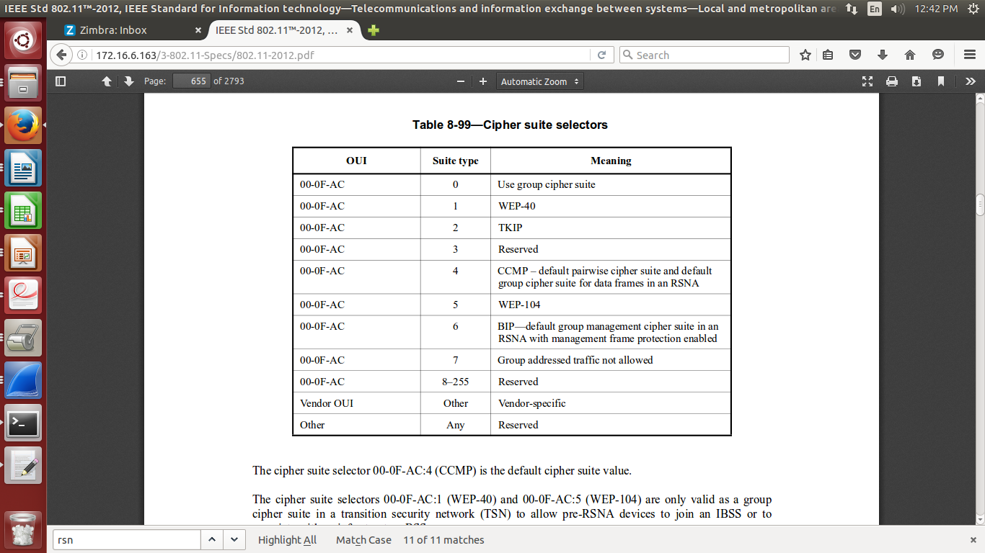

Slide 7
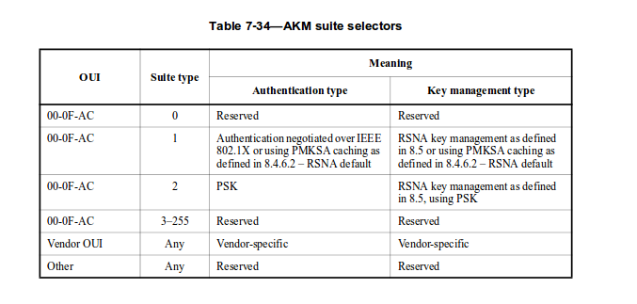

Slide 8
1.Preauthentication bit
  Set to 1 by AP –> Preauthentication supported by AP
  Set to 0 by AP –>Preauthentication is not supported by AP
  An 802.11 Station always setS the preauthentication bit to 0
  2.Bit 1: No Pairwise. If a STA supports WEP default key 0 simultaneously with a pairwise key then the STA sets the No Pairwise subfield of the RSN Capabilities field to 0.
    If a STA does not support WEP default key 0 simultaneously with a pairwise key then the STA sets the No Pairwise subfield of the RSN Capabilities field to 1.
3.PTKSA replay counter and GTKSA replay counters are used to for the TKIP for the Sequence and reorder purpose. 4..Capable/Optional: SSID supports PMF, but lets the client decide if he wants to use it or not
5. Required/Mandatory: SSID supports PMF, and clients can only connect to the SSID if they support PMF aswell
6.PeerKey Enabled. An AP STA sets the PeerKey Enabled subfield of the RSN Capabilities field to 1 to signal it supports PeerKey Handshake. This field is used by AP STA to describe its ability to support PeerKey Handshake.

Slide 9
Sniffer captures collected
1.WPA2-PSK -AES
2.WPA2-PSK -TKIP,AES
3.WPA2-WPA
4.WPA2-TKIP
5.WPA-TKIP

